Slide 1

Circular Flow
Lesson

Slide 2
Vocabulary: Resources
Productive resources are the natural, human, and capital resources that are available to make goods and services.
Productive resources are also known as factors of production.
People in households own resources.
People earn income when they provide resources in the market.

Slide 3
Vocabulary: Resources
Natural resources (land) are things that occur naturally in or on the earth.
Human resources (labor) are people who work.
Capital resources (capital goods) are things produced by people and used to produce other goods and services. Capital resources include buildings, equipment, and tools.
Entrepreneurship refers to people who combine resources and take risks to start and operate businesses that produce goods and services

Slide 4
Round 1 Goals and Instructions
Businesses should buy as many resources as possible to produce as many eagle toys as possible.
Households should sell their resources for as much money as possible.
Businesses need three resource cards: one unit each of natural resources, human resources, and capital resources.
At the end of Round 1, businesses will take the sets of three resource cards to the factory and exchange each set of three cards for one eagle toy

Slide 5
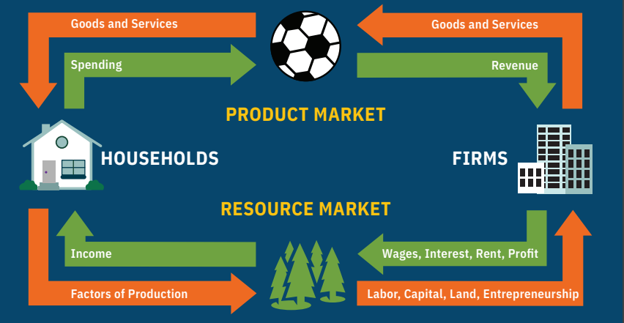
Circular Flow (pt.1)

Slide 6
Round 2 Goals and Instructions
Businesses should sell eagle toys to the households and try to make as much money as possible.
Households should buy as many eagle toys as possible with the income they earned from selling their resources in Round 1.
If households have resources left from Round 1, they may sell them to businesses.
Businesses may buy these resources and bring sets of three resources—one natural, one human, and one capital—to turn into product.
Businesses may then sell those products (eagle toys)

Slide 7
Circular Flow Chart (pt. 2)

Slide 8
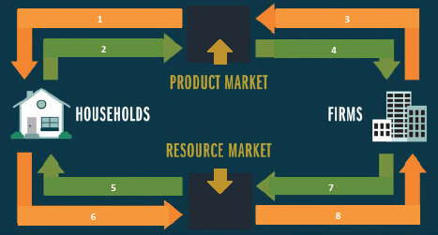
Circular Flow Chart (pt. 3)

Slide 9
Closure
What are productive resources
Who sells productive resources in the economy?
What are the three types of productive resources?
What type of income is earned by each resource?

Slide 10
Closure (pt. 2)
Who buys resources in the resource market?
Why do businesses buy resources?
Who buys goods and services in the product market?
What payment do businesses receive for selling goods and services?

Slide 11
Closure (pt. 3)
What is the role of government in the circular flow of the economy?
How are transfer payments and subsidies different from payments in the resource and product markets?

Slide 12
Circular Flow
Conclusion

